Slide 1
18AIE332T - Image and Video Processing

Slide 2
MODULE - 2
Image Enhancement and Restoration

Slide 3
What is Histogram?
In digital image processing, the histogram is used for graphical representation of a digital image. A graph is a plot by the number of pixels for each tonal value. Nowadays, image histogram is present in digital cameras. Photographers use them to see the distribution of tones captured.
In a graph, the horizontal axis of the graph is used to represent tonal variations whereas the vertical axis is used to represent the number of pixels in that particular pixel.
Black and dark areas are represented in the left side of the horizontal axis, medium grey color is represented in the middle, and the vertical axis represents the size of the area.

Slide 4
Topics to be Discussed:
Spatial Domain Methods: Histogram Processing
Histogram equalization, Matching
Local Histogram Processing
Statistics for histogram
Fundamentals of Spatial Filtering : Smoothing Spatial filters - linear Filters
Order statistics nonlinear filters -Sharpening spatial filters
Combined spatial enhancement methods
Frequency Domain methods: Basics of filtering in frequency domain
image smoothing, image sharpening, selective filtering,
Homomorphic filtering, A model of image degradation/ restoration
Process, Noise models, Adaptive filters, Band reject Filters, Band pass Filters, Inverse Filtering – Wiener, Singular value decomposition

Slide 5
Applications & Processing Techniques
Applications of Histograms
In digital image processing, histograms are used for simple calculations in software.
It is used to analyze an image. Properties of an image can be predicted by the detailed study of the histogram.
The brightness of the image can be adjusted by having the details of its histogram.
The contrast of the image can be adjusted according to the need by having details of the x-axis of a histogram.
It is used for image equalization. Gray level intensities are expanded along the x-axis to produce a high contrast image.

Slide 6
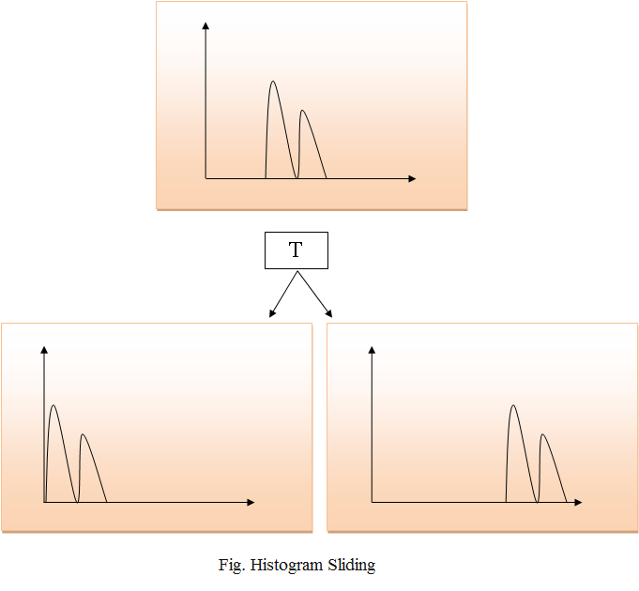
Processing Techniques

Slide 7
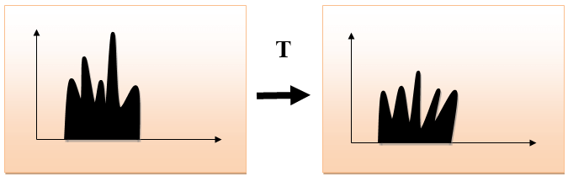
Histogram Stretching

Slide 8
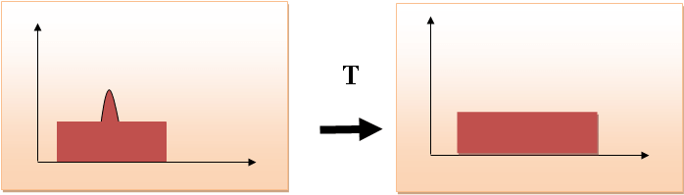
Histogram Equalization

Slide 9
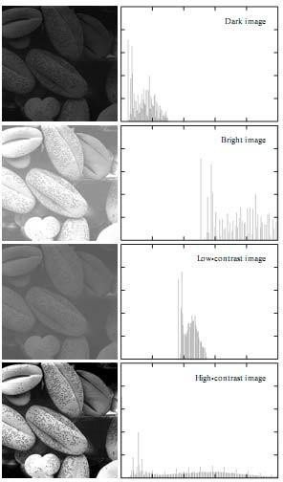
Histogram Processing
Histograms are the basis for numerous spatial domain processing techniques. Histogram manipulation can be used for image enhancement, as shown in this section.
As an introduction to histogram processing for intensity transformations, consider the below Diagram
four basic intensity characteristics: dark, light, low contrast, and high contrast. The right side of the figure shows the histograms corresponding to these images. The horizontal axis of each histogram plot corresponds to intensity values, The vertical axis corresponds to values of or if the values are normalized. Thus, histograms may be viewed graphically simply as plots of

Slide 10
Histogram Processing Formula :
h(rk) = nk.rk
p(rk) = nk>MN
H= horizontal, rk- intensity values , nk- number of pixels
h(rk) = nk is the discrete function
P(rk) = probability of the occurrence based on the intensity rk
M and N are the row and column dimension of the image.
Result :
The sum of all components of a normalized histogram is
equal to 1.

Slide 11
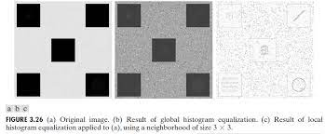
Histogram Statistics for Image Enhancements
Statistics obtained directly from an image histogram can be used for image enhancement. Let r denote a discrete random variable representing intensity values in the range(0, L-1) and let p(ri) denote the normalized histogram
mn(r) = a L-1 i=0 (ri - m) np(ri)
As image shows the level of statistics based on the grey scale.

Slide 12
Fundamentals of Spatial Filtering
There are several basic concepts underlying the use of spatial filters for image processing. Spatial filtering is one of the principal tools used in this field for a broad spectrum of applications, so it is highly advisable that you develop a solid understanding of these concepts,
The name filter is borrowed from frequency domain processing where “filtering” refers to accepting (passing) or rejecting certain frequency components. For example, a filter that passes low frequencies is called a lowpass filter which means blur or otherwise called as smooth of an image.
We can accomplish a similar smoothing directly on the image itself by using spatial filters (also called spatial masks, kernels, templates, and windows).

Slide 13
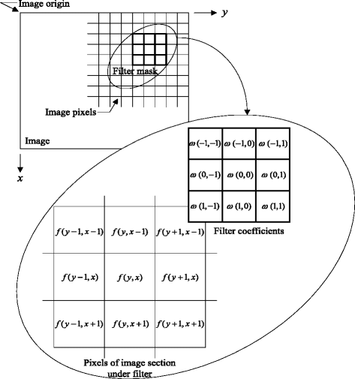
Spatial filter consists of (1) a neighborhood, (typically a small rectangle), and (2) a predefined operation that is performed on the image pixels encompassed by the neighborhood.
A processed (filtered) image is generated as the center of the filter visits each pixel in the input image. If the operation performed on the image pixels is linear, then the filter is called a linear spatial filter Otherwise, the filter is nonlinear

Slide 14
SMOOTHING SPATIAL FILTERS
Smoothing filters are used for blurring and for noise reduction.
Blurring is used in preprocessing tasks, such as removal of small details from an image prior to (large) object extraction, and bridging of small gaps in lines or curves.
Noise reduction can be accomplished by blurring with a linear filter and also by nonlinear filtering.
Smoothing Linear Filters
Order Statistics Non- Linear Filters

Slide 15
Smoothing Linear Filters
The output (response) of a smoothing, linear spatial filter is simply the average of the pixels contained in the neighborhood of the filter mask. These filters sometimes are called averaging filters.
The idea behind smoothing filters is straightforward.
By replacing the value of every pixel in an image , the average of the intensity levels in the neighborhood is defined by the filter mask, this process results in an image with reduced “sharp” transitions in intensities.
Because random noise typically consists of sharp transitions in intensity levels, the most obvious application of smoothing is noise reduction.
However, edges (which almost always are desirable features of an image) also are characterized by sharp intensity transitions, so averaging filters have the undesirable side effect that they blur edges.

Slide 16
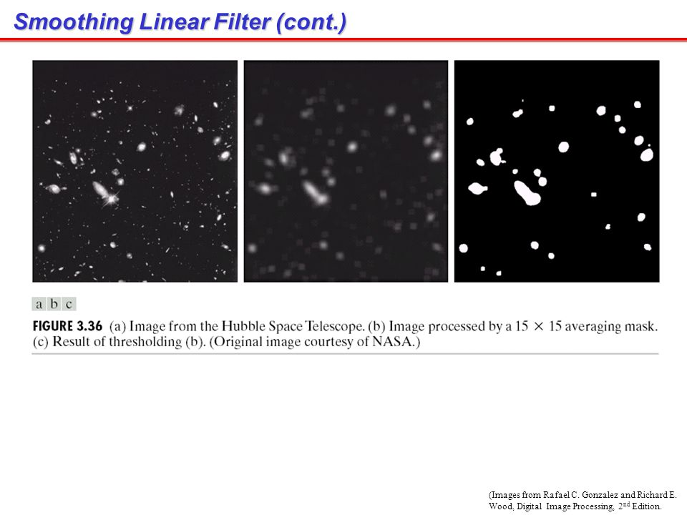
Order-statistic Non-Linear filters
Order-statistic filters are nonlinear spatial filters whose response is based on ordering (ranking) the pixels contained in the image area encompassed by the filter, and then replacing the value of the center pixel with the value determined by the ranking result.
The best-known filter in this category is the median filter, which, as its name implies, replaces the value of a pixel by the median of the intensity values in the neighborhood of that pixel.
Median filters are particularly effective in the presence of impulse noise, also called salt-and-pepper noise because of its appearance as white and black dots superimposed on an image.

Slide 17
Sharpening Spatial Filters
The principal objective of sharpening is to highlight transitions in intensity.
Uses:
1.Electronic printing
2.medical imaging
3.Industrial inspection
4.Autonomous guidance in military systems
Fundamentally, the strength of the response of a derivative operator is proportional to the degree of intensity in sharpening.
Thus, image differentiation enhances edges and other discontinuities (such as noise) and deemphasizes areas with slowly varying intensities.

Slide 18
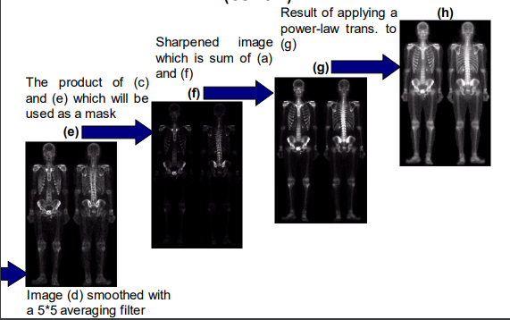
Combining Spatial Enhancement Methods
In this section we illustrate by means of an example how to combine several of the approaches developed thus far in this chapter to address a difficult image enhancement task.
With a few exceptions, like combining blurring with thresholding.
The image given below is a nuclear whole body bone scan, used to detect diseases such as bone infection and tumors.
Our objective is to enhance this image by sharpening it and by bringing out more of the skeletal detail. The narrow dynamic range of the intensity levels and high noise content make this image difficult to enhance.

Slide 19
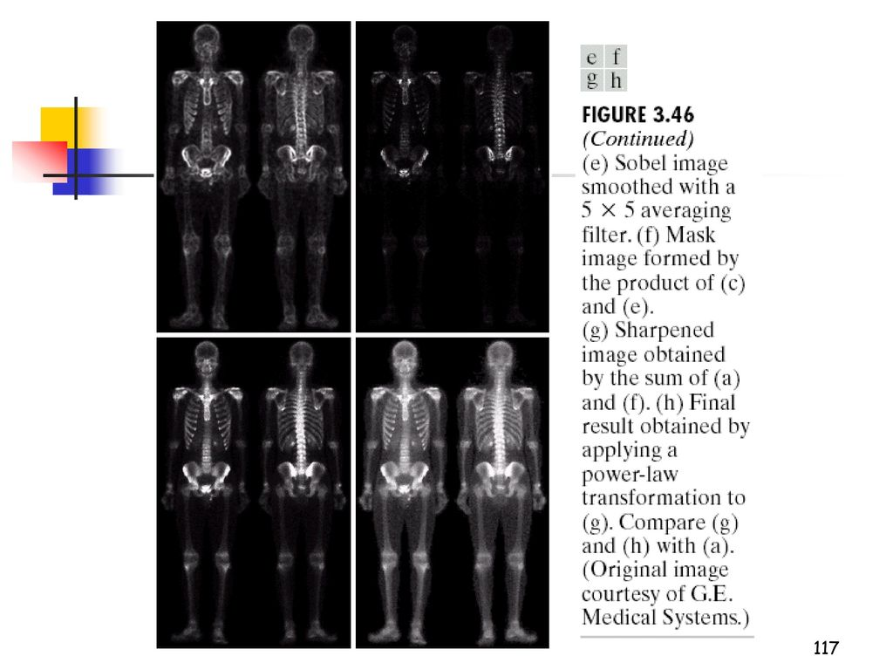
The strategy we will follow is to utilize the Laplacian to highlight fine detail, and the gradient to enhance prominent edges. For reasons that will be explained shortly, a smoothed version of the gradient image will be used to mask the Laplacian image (see Fig. 2.30 regarding masking). Finally, we will attempt to increase the dynamic range of the intensity levels by using an intensity transformation.

Slide 20
Frequency Domain : Basics of Filtering in Frequency Domain
The material in the previous two sections can be summarized as follows:
1. Given an input image (x, y) of size M*N, obtain the padding parameters P and Q from Eqs.Typically, we select P=2M and Q=2N.
2. Form a padded image,fp(x,y) of size P*Q by appending the necessary number of zeros to f(x, y).
3. Multiply fp(x,y) by (-1)x+y to center its transform.
4. Compute the DFT, (u, v), of the image from step 3.
5. Generate a real, symmetric filter function, H(u, v), of size with center at coordinates (P 2, Q 2).† Form the product using array multiplication; that is,
6. Obtain the processed image: where the real part is selected in order to ignore parasitic complex components resulting from computational inaccuracies, and the subscript p indicates that we are dealing with padded arrays.
7. Obtain the final processed result, (x, y), by extracting the region

Slide 21
gp(x, y) = Ereal C-1 [G(u, v)]D F(-1)x+y
Filtering in the frequency domain consists of modifying the Fourier transform of an image and then computing the inverse transform to obtain the processed result. Thus, given a digital image, (x, y), of size the basic filtering equation in which we are interested has the form
g(x, y) = -1 [H(u, v)F(u, v)]

Slide 22
Image Smoothing and Image Sharpening
We begin with lowpass filters. Edges and other sharp intensity transitions (such as noise) in an image contribute significantly to the high frequency content of its Fourier transform.
Hence, smoothing (blurring) is achieved in the frequency domain by high-frequency attenuation; that is, by lowpass filtering.
we consider three types of lowpass filters: ideal, Butterworth, and Gaussian.
These three categories cover the range from very sharp (ideal) to very smooth (Gaussian) filtering. The Butterworth filter has a parameter called the filter order.
so all filter functions, (u, v), are understood to be discrete functions of size that is, the discrete frequency variables are in the range
u = 0, 1, 2, Á , P - 1 v = 0, 1, 2, Á , Q - 1.

Slide 23
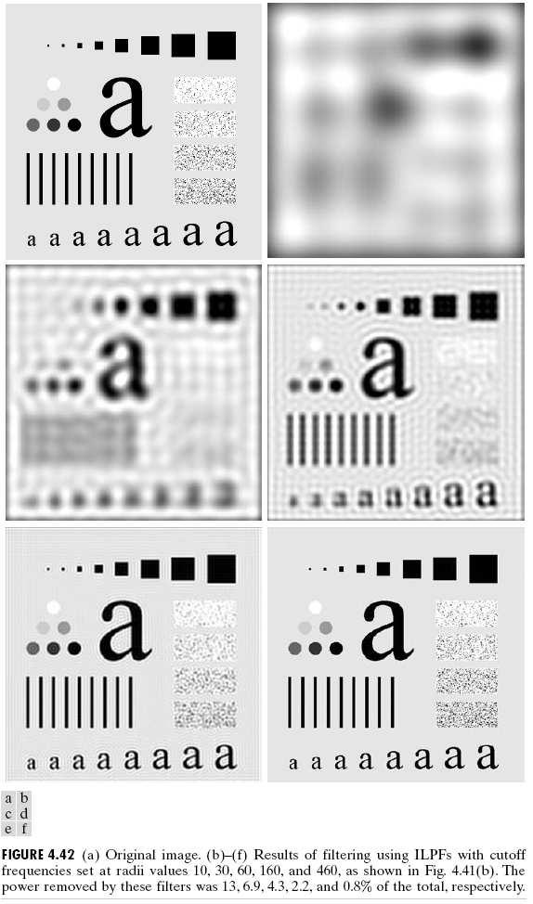
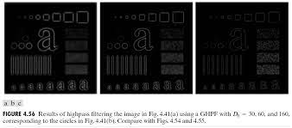
Image Sharpening:
Edges and other abrupt changes in intensities are associated with high-frequency components, image sharpening can be achieved in the frequency domain by high pass filtering, which attenuates the low-frequency components without disturbing high-frequency information in the Fourier transform.
Results of high pass filtering the image in Fig. 4.41(a) using an IHPF with D0 = 30, 60, and 160.

Slide 24
selective filtering
There are applications in which it is of interest to process specific bands of frequencies or small regions of the frequency rectangle. Filters in the first category are called band reject or bandpass filters, respectively.
Filters in the second category are called notch filters.
These types of filters are easy to construct using the concepts from the previous two sections. Table 4.6 shows expressions for ideal, Butterworth, and Gaussian band reject filters, where D is the distance from the center of the frequency rectangle, as given in Eq. (4.8-2), is the radial center of the band, and W is the width of the band. Figure 4.63(a) shows a Gaussian band reject filter in image form, where black is 0 and white is 1.

Slide 25
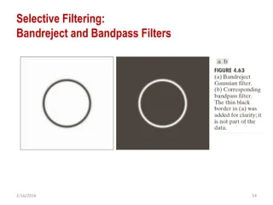
Notch filters
Notch filters are the most useful of the selective filters. A notch filter rejects (or passes) frequencies in a predefined neighborhood about the center of the frequency rectangle. Zero-phase-shift filters must be symmetric about the origin, so a notch with center at must have a corresponding notch at location Notch reject filters are constructed as products of high pass filters whose centers have been translated to the centers of the notches.

Slide 26
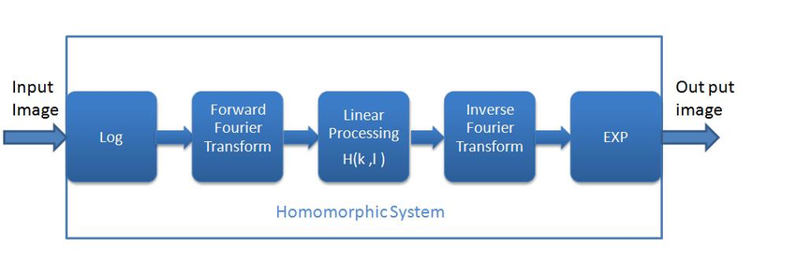

Homomorphic Filtering
Homomorphic filter is a method that can compress the range of image brightness and enhance the image contrast in the frequency domain. It can not only eliminate the influence of uneven illumination, but also can enhance the detail of the image.

Slide 27
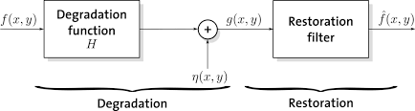
A model of image degradation/ restoration process
As Figure shows, the degradation process is modeled in this chapter as a degradation function that, together with an additive noise term, operates on an input image to produce a degraded image . Given , some knowledge about the degradation function H, and some knowledge about the additive noise term the objective of restoration is to obtain an estimate of the original image. We want the estimate to be as close as possible to the original input image and, in general, the more we know about H and the closer will be to . The restoration approach used throughout most of this chapter is based on various types of image restoration filters.

Slide 28
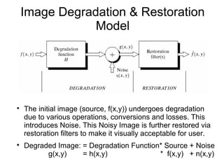

Slide 29
Noise Models
The principal sources of noise in digital images arise during image acquisition and/or transmission. The performance of imaging sensors is affected by a variety of factors, such as environmental conditions during image acquisition, and by the quality of the sensing elements themselves. For instance, in acquiring images with a CCD camera, light levels and sensor temperature are major factors affecting the amount of noise in the resulting image. Images are corrupted during transmission principally due to interference in the channel used for transmission. For example, an image transmitted using a wireless network might be corrupted as a result of lightning or other atmospheric disturbance.

Slide 30
Adaptive Filters
Once selected, the filters discussed thus far are applied to an image without regard for how image characteristics vary from one point to another. In this section we take a look at two adaptive filters whose behavior changes based on statistical characteristics of the image inside the filter region defined by the rectangular window As the following discussion shows, adaptive filters are capable of performance superior to that of the filters discussed thus far. The price paid for improved filtering power is an increase in filter complexity. Keep in mind that we still are dealing with the case in which the degraded image is equal to the original image plus noise. No other types of degradations are being considered yet.

Slide 31
Band reject Filters, Band pass Filters
One of the principal applications of band reject filtering is for noise removal in applications where the general location of the noise component(s) in the frequency domain is approximately known. A good example is an image corrupted by additive periodic noise that can be approximated as two-dimensional sinusoidal functions. It is not difficult to show that the Fourier transform of a sine consists of two impulses that are mirror images of each other about the origin of the transform. Their locations are given in Table 4.3.The impulses are both imaginary (the real part of the Fourier transform of a sine is zero) and are complex conjugates of each other.
A bandpass filter performs the opposite operation of a bandreject filter. how the transfer function of a bandpass filter is obtained from a corresponding bandreject filter with transfer function by using the equation.

Slide 32
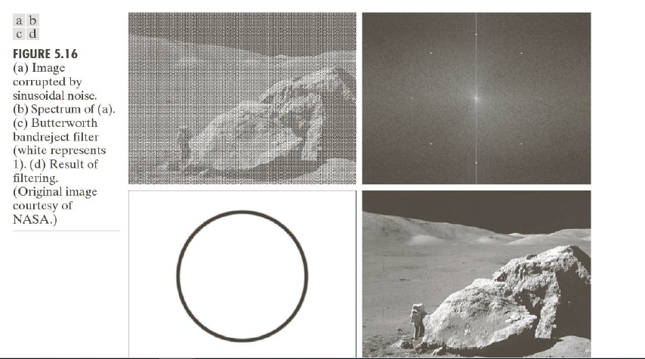

Slide 33
Inverse Filtering – Wiener
The inverse filtering is a restoration technique for deconvolution, i.e., when the image is blurred by a known lowpass filter, it is possible to recover the image by inverse filtering or generalized inverse filtering. However, inverse filtering is very sensitive to additive noise.
The approach of reducing one degradation at a time allows us to develop a restoration algorithm for each type of degradation and simply combine them. The Wiener filtering executes an optimal tradeoff between inverse filtering and noise smoothing. It removes the additive noise and inverts the blurring simultaneously.
The Wiener filtering is optimal in terms of the mean square error. In other words, it minimizes the overall mean square error in the process of inverse filtering and noise smoothing. The Wiener filtering is a linear estimation of the original image. The approach is based on a stochastic framework. The orthogonality principle implies that the Wiener filter in Fourier domain can be expressed as follows:

Slide 34

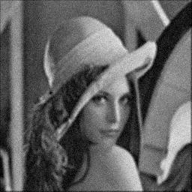
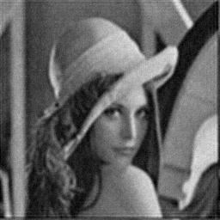
Formula:
H(f1,f2)- blurring filter , s(f1,f2,..)- power of original image w(f1,f2)- wiener filtering

Slide 35
Singular Value Decomposition
The process of Singular Value Decomposition (SVD) involves breaking down a matrix A into the form .
This computation allows us to retain the important singular values that the image requires while also releasing the values that are not as necessary in retaining the quality of the image.
The singular values of an m × n matrix A are the square roots of the eigenvalues of the n × n matrix AT A, which are typically organized by magnitude in decreasing order.

Slide 36
The Singular Value Decomposition is so named due to the singular values that are identified and isolated from matrix A.
By applying the process of Singular Value Decomposition to images by using pixel saturation matrices for grayscale or full color images, we can compress the storage size of an image even while retaining the number of pixels.
We have isolated the least important pieces of information that are stored in the images and have removed them methodically leaving only the most important components of the image leaving only the most important components of the images.
This process of removing the smallest singular values from the saturation matrices allows us to retain as much of the image quality as possible

Slide 37
THANK YOU

